Slide 1

SENTIMENT ANALYSIS ON AMAZON PRODUCT REVIEWS
<team name>
<Mentor Name>
<DD/MMM/YY>
To be filled by Project group

Slide 2
Business Problem:
Example
High warranty cost and not sure if all the claims are genuine
Objective:
The objective of the analysis is to predict an item when sold, what is the probability that customer would file fraudulent / Genuine warranty and to understand important factors associated with them

Slide 3
Project Architecture / Project Flow

Slide 4
Exploratory Data Analysis (EDA) and
Feature Engineering

Slide 5
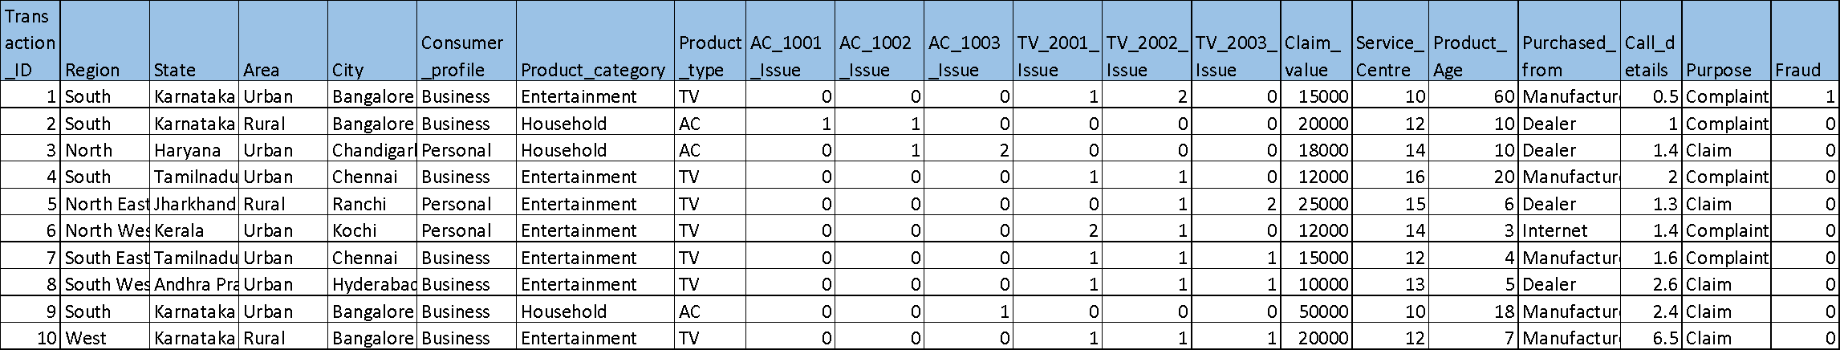
Data set details
Example
How many rows, columns and unique values
Date ranges
Missing values
Etc..

Slide 6
Exploratory Data Analysis (EDA)
Example
71.87% of all the loans are two wheeler
TN, Gujarat, AP one (Telengana), Karnataka, Maharashtra contribute to 87% of total defaults; Central, Orissa, UP, each have less than 7% defaults
List out all your queries:
CustNetOutflow & CustDisbursementAmt has ‘0’ & negative values ?? Can it be?
CustFinanInterest 7800 entries out of 35k entries have interest rate < 1%

Slide 7
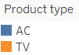
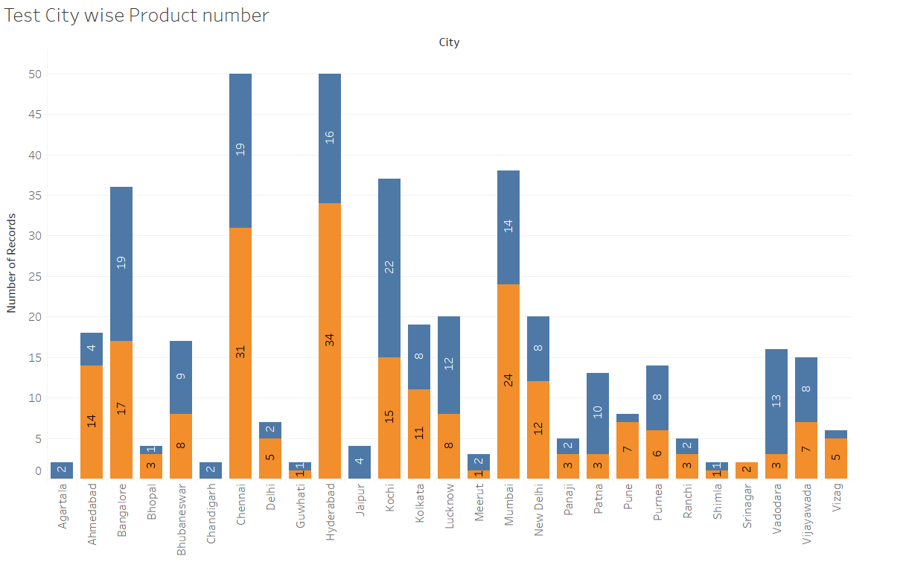
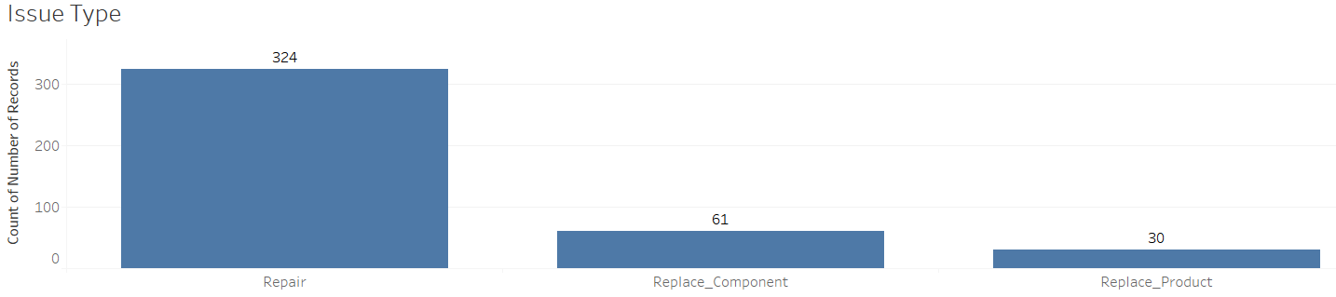
EDA
Look for problems in the data such as class imbalance, missing values, impossible values, and patterns ,similarities, distributions etcs..
Treat all the problems with appropriate techniques

Slide 8
Feature Engineering

Slide 9
Model Building

Slide 10
Template for Model results presentation
Model - SVM
Algorithms
Data set details
Algorithm details and configuration
Data Partition details
Accuracy:
Class wise accuracies
Recall
Precision
F1 score
Etc..

Slide 11
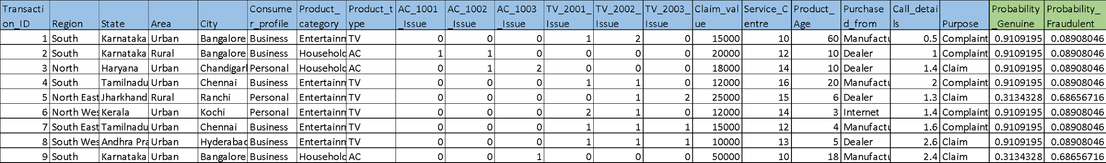
Model Predictions
Predicted probabilities for each transaction
Transaction data fed to the model
Example

Slide 12
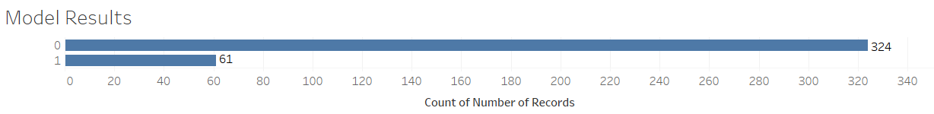
Model Results
Example
Model generated the output for the transaction data set in which 324 transactions are genuine(0) claims and 61 transaction are fraudulent(1)

Slide 13
Model Deployment using R shiny / Flask or any other method

Slide 14
Challenges faced?
How did you overcome?

Slide 15
Thank you

